Slide 1
Employee Data Analysis using Excel
STUDENT NAME:D.Santhalakshmi
REGISTER NO:312200883
DEPARTMENT:B.com(general)
COLLEGE: Pachaiyapaa’s college for womens, kanchipuram

Slide 2
PROJECT TITLE
Visualizing employee attendance trends with Excel charts

Slide 3

AGENDA
Problem statement Project overview Who are the end users Our solution and it’s proposition Dataset and Description The wow in our solution Modelling
Results
Conclusion
3/21/2024 Annual Review

Slide 4
PROBLEM STATEMENT
Start a new Excel spreadsheet and create columns for each date of the particular month.
Create another column for employees to input their names in the left corner.
Fill the columns matching weekends and public holidays with some color.
Apply data validation.

Slide 5
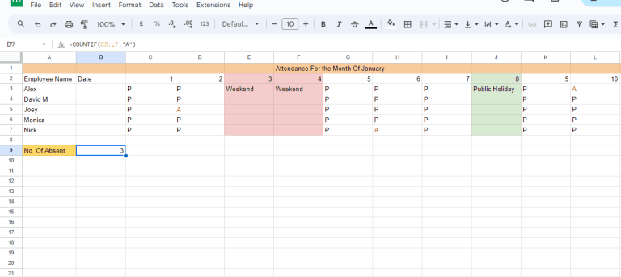

PROJECT OVERVIEW
.

Slide 6

WHO ARE THE END USERS?
Start a new Excel spreadsheet and create columns for each date of the particular month.
Create another column for employees to input their names in the left corner.
Fill the columns matching weekends and public holidays with some color.
Use the Home tab to lock the cells beside the others where employees need to enter their data.

Slide 7
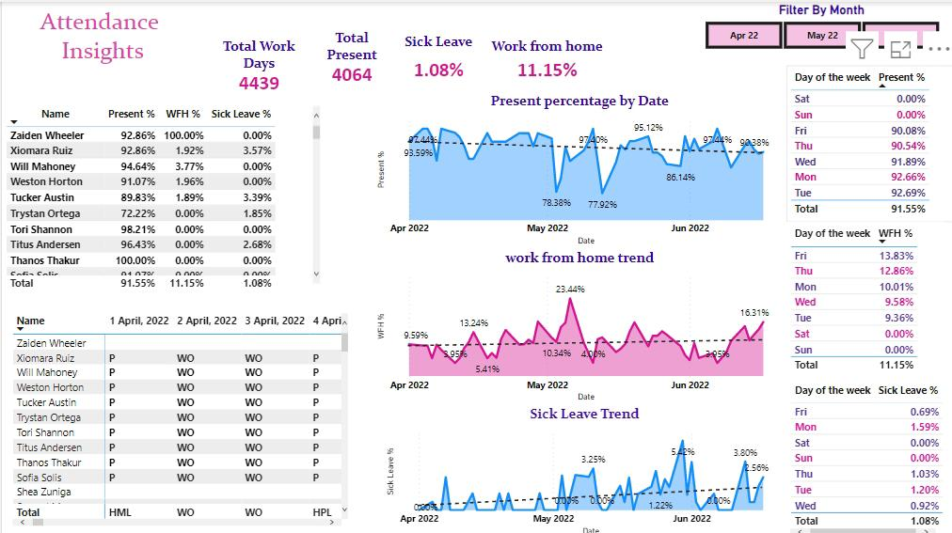
OUR SOLUTION AND ITS VALUE PROPOSITION

Slide 8

Dataset Description
About Dataset
Context: This dataset contains information about employees in a company, including their educational backgrounds, work history, demographics, and employment-related factors. It has been anonymized to protect privacy while still providing valuable insights into the workforce.
Columns:
Education: The educational qualifications of employees, including degree, institution, and field of study.
Joining Year: The year each employee joined the company, indicating their length of service.
City: The location or city where each employee is based or works.
Payment Tier: Categorization of employees into different salary tiers.
Age: The age of each employee, providing demographic insights.
Gender: Gender identity of employees, promoting diversity analysis.
Ever Benched: Indicates if an employee has ever been temporarily without assigned work.

Slide 9
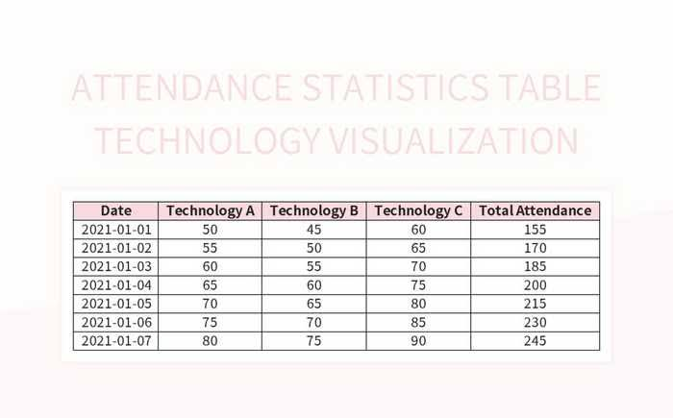
THE "WOW" IN OUR SOLUTION
3/21/2024 Annual Review
9

Slide 10
MODELLING
Attendance Monitoring: Give the HR a view of employee’s attendance that includes the working location of employee. Using matrix individual’s daily attendance can be represented. Charts and graphs help to analyse the attendance of an employee easily.Skillset Monitoring: The HR who wants to know the count of employees based on skillset, job role, or work experience; the dashboard can present all the probable combination of above data.Project Monitoring: The project monitoring dashboard makes an HR to know the work status and available employees for the new project. The employees involved in present project, their role in project and the present task an employee is working on, being visualising the above aspects can make HR to monitor and take necessary actions, allocate resources to employee.
10

Slide 11
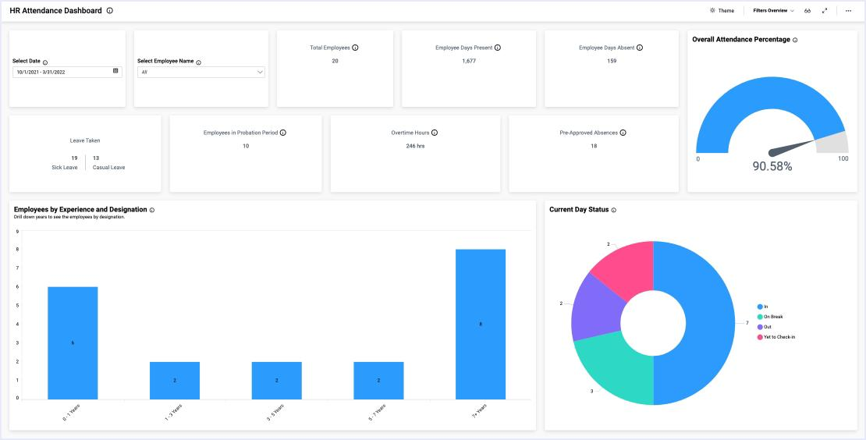
RESULTS
11

Slide 12
conclusion
In conclusion, employee development and retention are essential for the success of any organization. By investing in employee retention, training and development, you can create a workforce that is skilled, motivated, and loyal. In conclusion, attendance management systems play a pivotal role in modernizing education and driving institutional success. With Proctur leading the way in innovation and excellence, schools and colleges can embrace the future with confidence, knowing that their attendance management needs are in capable hands.

